Slide 1
SOEN 341 week 6
PSP summary
Watts Humphrey and
http://en.wikipedia.org/wiki/Personal_Software_Process

Slide 2
PSP Goals
Help software engineers to:
  Improve their estimating and planning skills.
  Make commitments they can keep.
  Manage the quality of their projects.
  Reduce the number of defects in their work.

Slide 3
PSP strategy
Plan and track work based on scripts
Measure goals
Track performance against goals
Feedback results to improve process
  Measure
    Program size
    Time
    Defects
  Record results for feedback

Slide 4
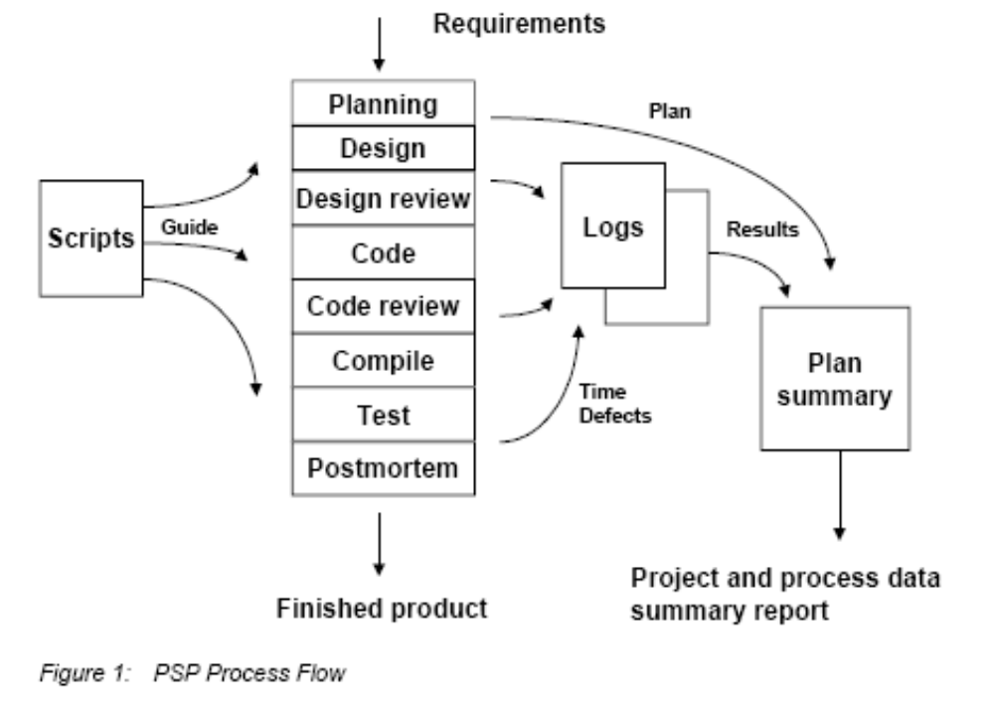
PSP process

Slide 5
Important points to retain
The key to process improvement is measurement.
The measurements are analyzed, and the experience is fed back into the process:
  Size
  Resources
  Schedule
The following slide expands the planning phase of the previous slide

Slide 6
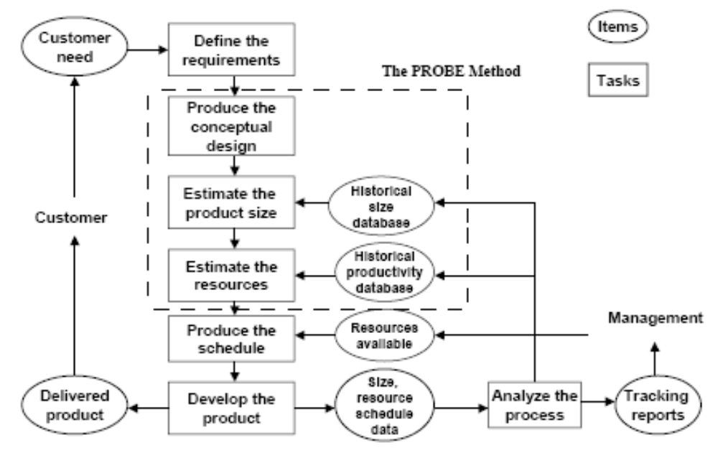
PSP Planning Detail

Slide 7
Quality Measures
The principal quality focus of the PSP is on defects.
To manage defects, engineers need data on the defects they inject, the phases in which they injected them, the phases in which they found and fixed them, and how long it took to fix them.
With the PSP, engineers record data on every defect found in every phase, including reviews, inspections, compiling, and testing.
These data are recorded in the defect recording log.

Slide 8
Measurement of Quality
.The principal PSP quality measures are
  • Defect density
  • Review rate
  • Development time ratios
  • Defect ratios
  • Yield
  • Defects per hour
  • Defect removal leverage
  • Appraisal to failure ratio (A/FR)

Slide 9
Development Time Ratios
The ratio of the time spent by an engineer in any two development phases.
In the PSP, the three development time ratios used in process evaluation are:
    design time to coding time,
    design review time to design time,
    code review time to coding time.

Slide 10
Design Quality
The design time to coding time measure is most useful in determining the quality of an engineer’s design work.
When engineers spend less time in designing than in coding, they are producing most of the design while coding.
This means that the design is not documented, the design cannot be reviewed or inspected, and design quality is probably poor.
The PSP guideline is that engineers should spend at least as much time producing a detailed design as they do in producing the code from that design.

Slide 11
The appraisal to failure ratio (A/FR)
This measures the quality of the engineering process, using cost-of-quality parameters
A stands for the appraisal quality cost, or the percentage of development time spent in quality appraisal activities. (time spent in design and code reviews and repairing the defects found in those reviews.
F stands for the failure quality cost, which is the time spent in failure recovery and repair. (compile and unit test, fixing, recompiling, and retesting)
The A/FR measure provides a useful way to assess quality, both for individual programs and to compare the quality of the development processes used for several programs. It also indicates the degree to which the engineer attempted to find and fix defects early in the development process.
In PSP, engineers are told to plan for A/FR values of 2.0 or higher. This ensures that they plan adequate time for design and code reviews.

Slide 12
The Engineer’s Responsibility
The first PSP quality principle is that engineers are personally responsible for the quality of the programs they produce. Because the software engineer who writes a program is most familiar with it, that engineer can most efficiently and effectively find, fix, and prevent its defects.
The PSP provides a series of practices and measures to help engineers assess the quality of the programs they produce and to guide them in finding and fixing all program defects as quickly as possible.
In addition to quality measurement and tracking, the PSP quality management methods are early defect removal and defect prevention.

Slide 13
Early Defect Removal
The principal PSP quality objective is to find and fix defects before the first compile or unit test.
The PSP process includes design and code review steps in which engineers personally review their work products before they are inspected, compiled, or tested.
People tend to make the same mistakes repeatedly. Therefore, by analyzing data on the defects they have made and constructing a checklist of the actions needed to find those mistakes, engineers can find and fix defects most efficiently.
PSP-trained engineers find an average of 6.52 defects per hour in personal code reviews and 2.96 defects per hour in personal design reviews. This compares with 2.21 defects found per hour in unit testing By using PSP data, engineers can both save time and improve product quality.
For example, from average PSP data, the time to remove 100 defects in unit testing is 45 hours while the time to find that number of defects in code reviews is only 15 hours.

Slide 14
The PSP four core measures:
Size – the size measure for a product part, such as lines of code (LOC).
Effort – the time required to complete a task, usually recorded in minutes.
Quality – the number of defects in the product.
Schedule – a measure of project progression, tracked against planned and actual completion dates.

Slide 15
Process Phases
Requirements
Conceptual Design
Estimate size and resources
Produce the Schedule
Develop the product
Analyze the process
Update size and productivity databases

Slide 16
Measurement
Time: record time in a log
Size: LOC New and changed, Total
Quality
  number of defects
  Defect density
  Yield (%defects removed before compile and test)
  Development time ratios (design to coding….)
  Appraisal to failure ratio
    A: appraisal cost
    F: failure cost

Slide 17
Quality goal
High-quality software is the goal of the PSP, and quality is measured in terms of defects. A quality process should produce low-defect software that meets the user needs.
Software engineers are encouraged to conduct personal reviews for each phase of development.
The PSP phase structure includes two review phases:
  Design Review
  Code Review

Slide 18
Agile and PSP
In PSP, team members take responsibility for their own work and work together to agree a realistic plan.
PSP differs from Agile in its emphasis on documenting the process and its use of data for predicting and defining project schedules.

